Slide 1
Amy Grzymkowski, Deputy Director of WOTA

Slide 2
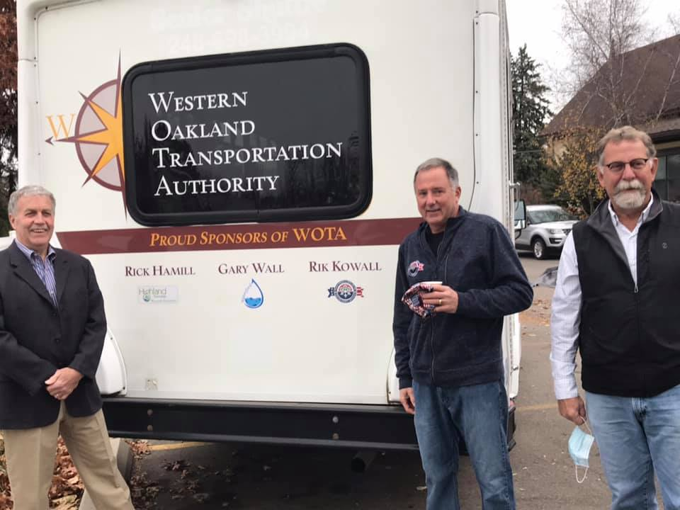
Who We Are
WOTA is a mission-driven organization, dedicated to providing mobility for those that need it most.
WOTA started in January 2020 through an interlocal agreement between Highland, White Lake, and Waterford Townships. City of Walled Lake joined officially in 2021.
Door-to-door, demand response transportation
46 employees
2022: 32,000+ rides, 367,000+ miles
2023: 20,400+ rides, 245,000+ miles
30 barrier-free vehicles, 1 vehicle for larger groups
Named recipient of the 2022 Oakland County Transit Millage
Hours: 6 am – 9 pm

Slide 3
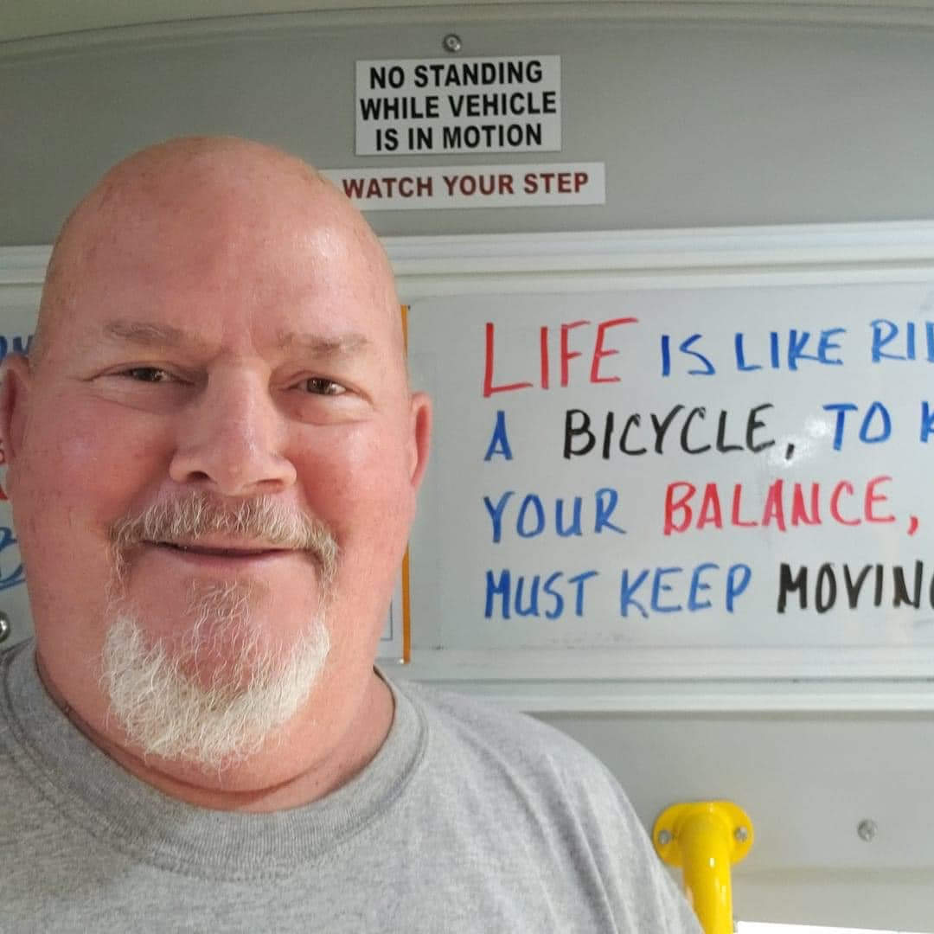
What We Do
WOTA provides transportation to those that cannot or do not have the ability to drive – seniors (55+), adults with disabilities (18+) and low-income families.
Local drivers and local dispatchers
No restrictions for ride types:
Medical appointments, including dialysis, chemo, physical therapy, and routine health appointments
Employment
Recreation
Shopping – from groceries to the mall, we go everywhere
Civic duties
Volunteering
Or, for any reason whatsoever
Independence – keeping or developing.

Slide 4
Service Area
Red Border: Residents served
Black Border: Where we go
Clarkston
Pontiac
West Bloomfield
Farmington
Novi
Wixom
Milford
Commerce

Slide 5
How to Ride
Residents register to ride online or may request a paper registration.
Proof of residency
Professional verification form
Companion also require a registration form
Call Dispatch at (248) 887-4979 two days before you need to ride.
Two different types of appointments
Set times
Open-ended appointments
Fares: $2 for any stop to any location in travel area.
For example: From home to doctor’s appointment and then back home – fare: $4.
Pay as you go or purchase a rider card for $20 (10 rides plus 1 bonus ride).
Companion riders ride for free.
Try us for free! When you register, we will send a Rider Card with 4 free rides.

Slide 6
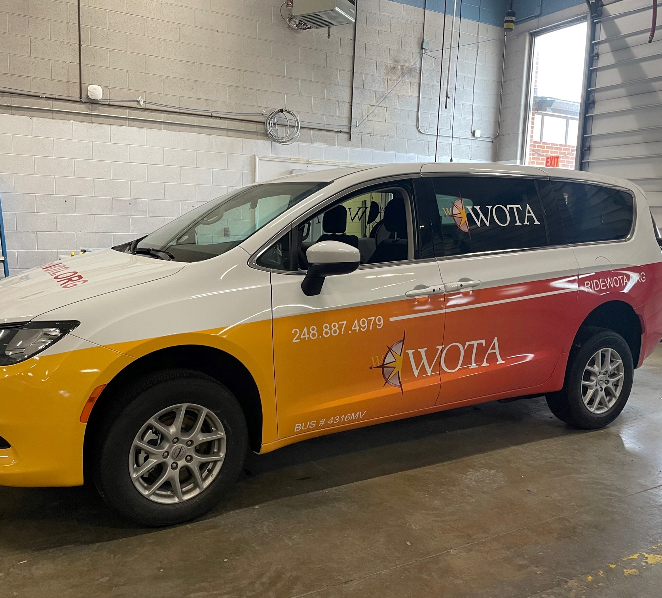
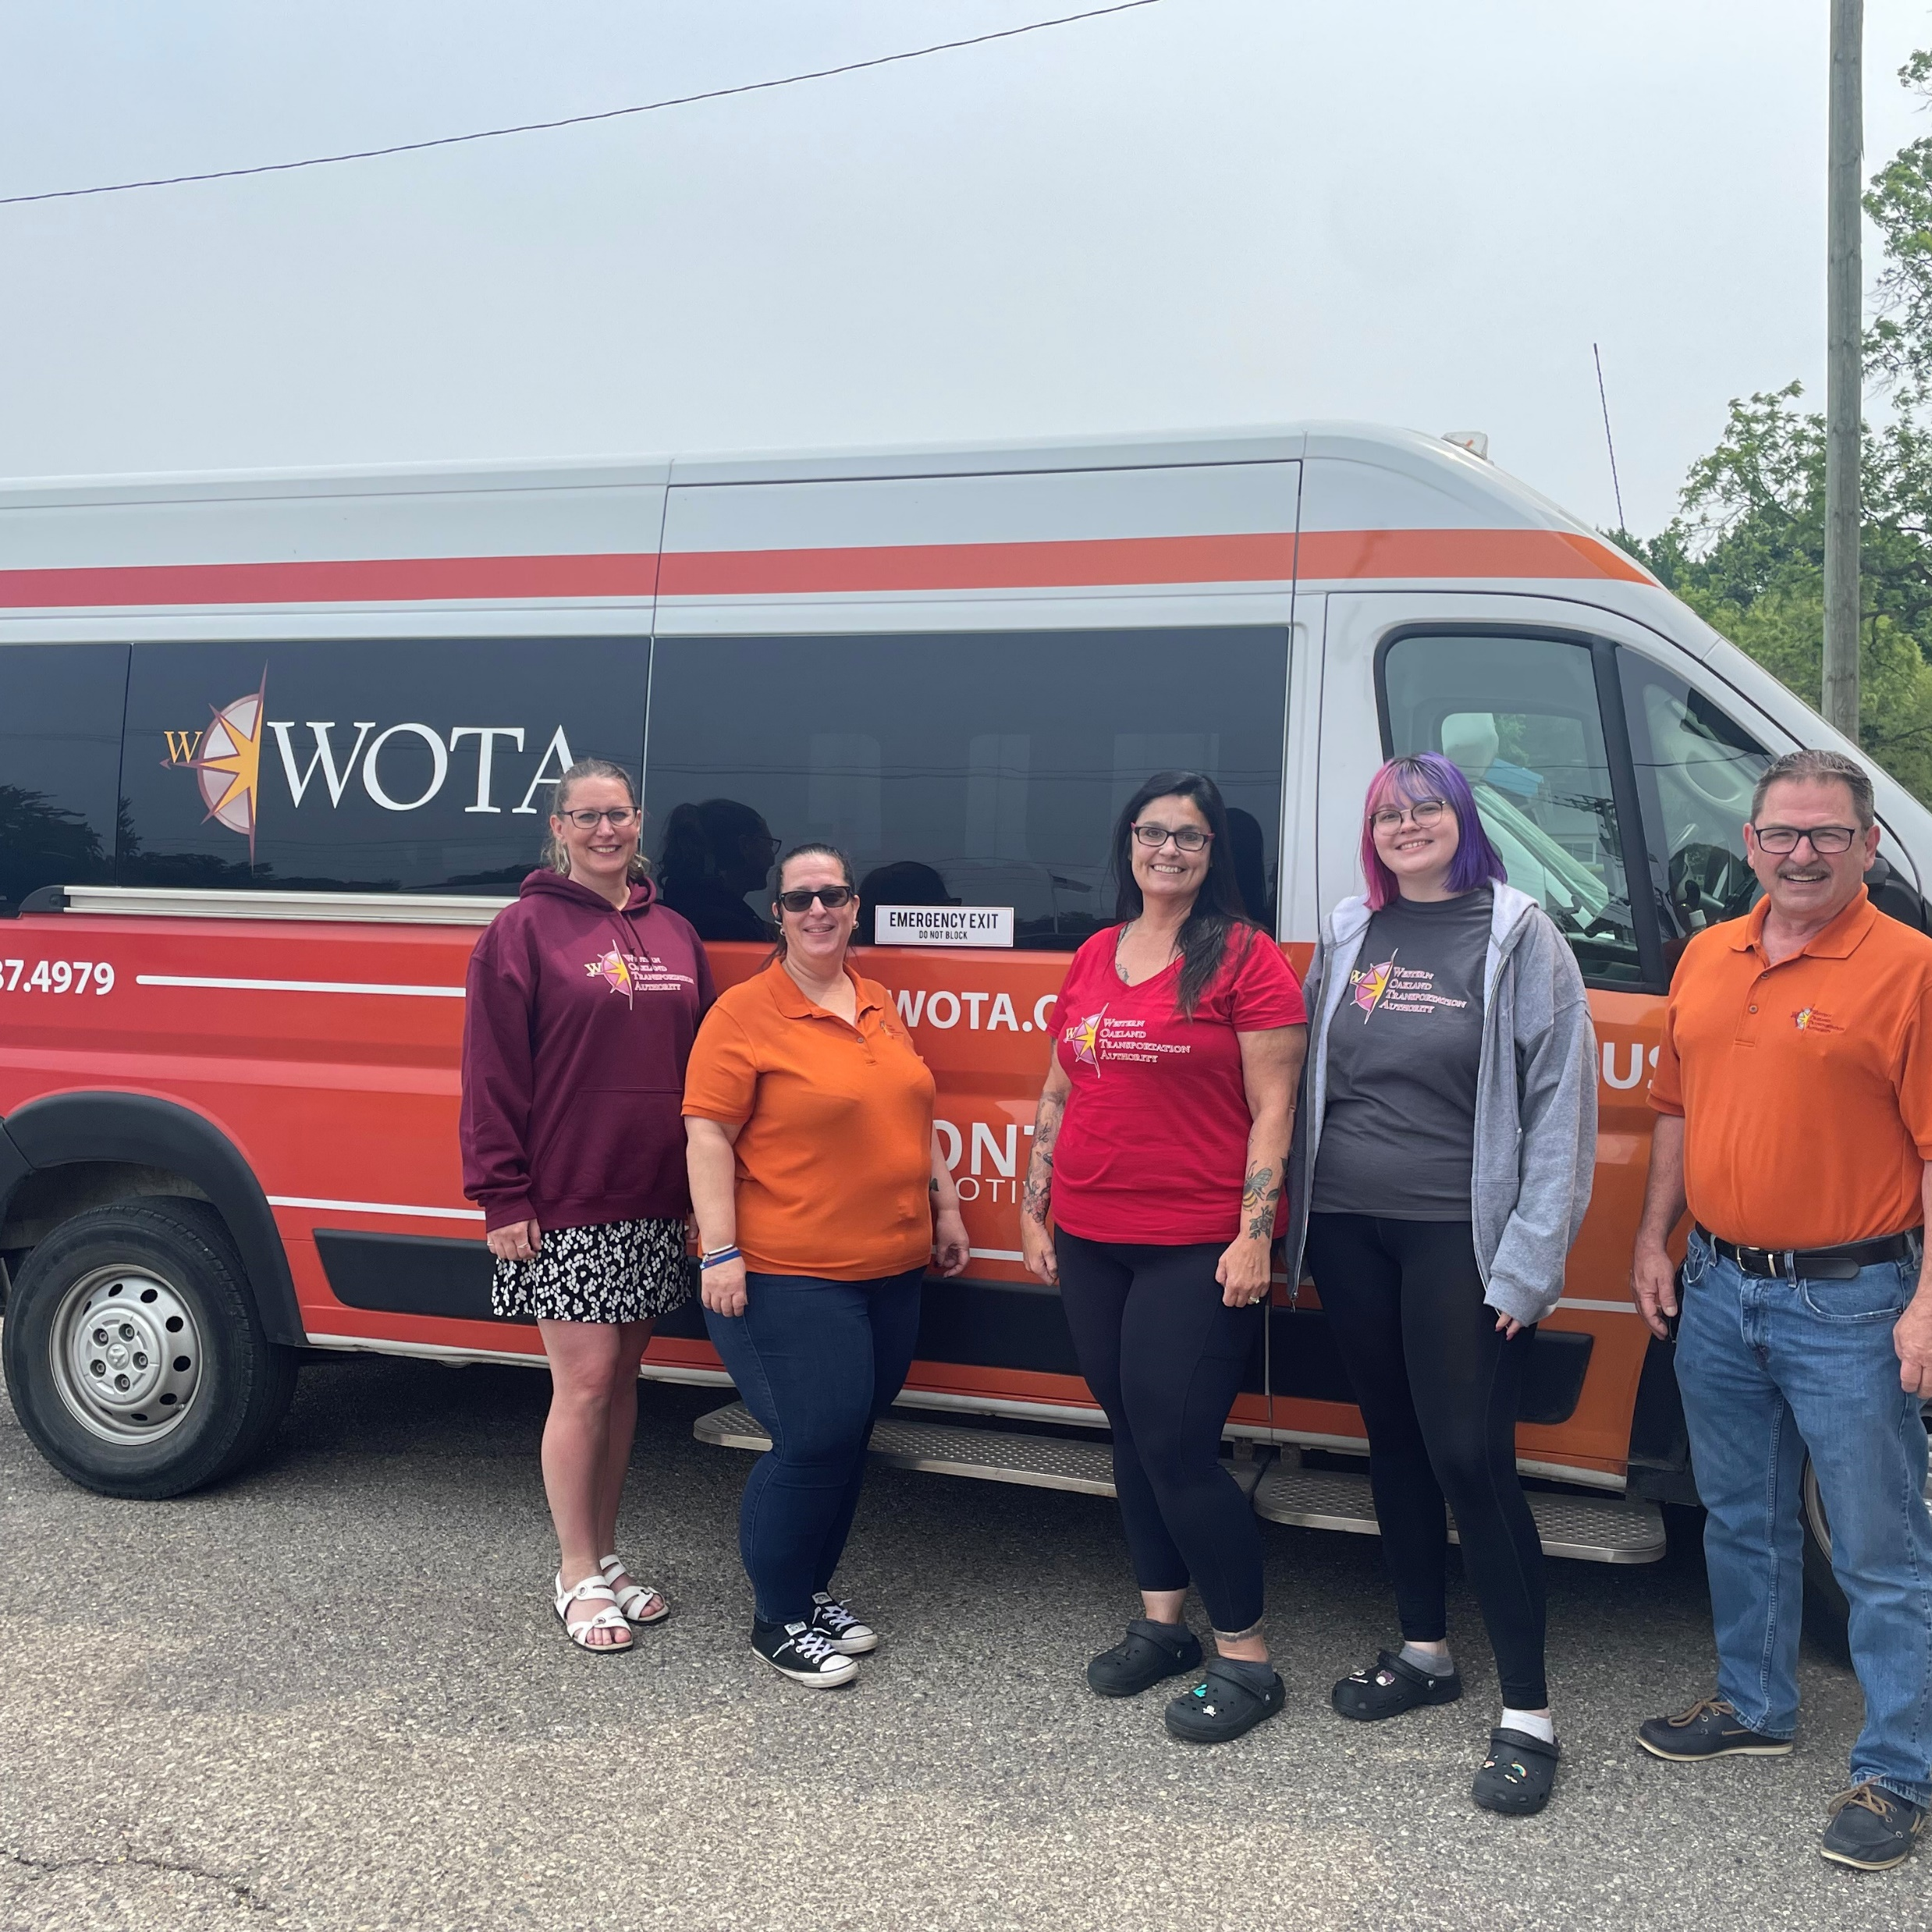
How We Make It Happen
46 mission-driven employees including management, dispatchers, drivers and office staff
Technology on our vehicles
Dispatching in real-time
Robust training program that includes ADA training, wheelchair securement, rider management and 2-3 weeks of in-vehicle training.
Demand response including flexibility with appointment times and the ability to schedule up to 1 year in advance. Dispatch can also set up recurring rides.

Slide 7
Thank you for allowing us serve you!

